Slide 1
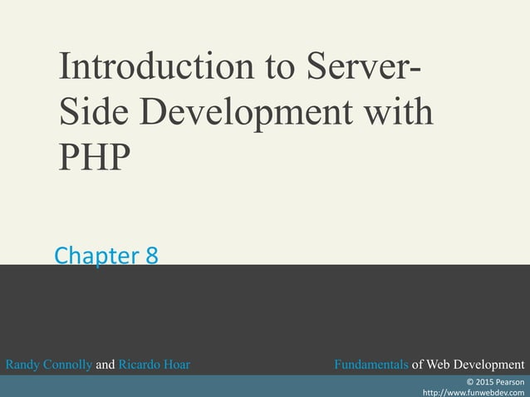

Slide 2
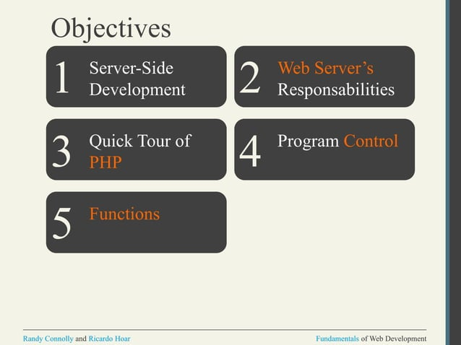

Slide 3
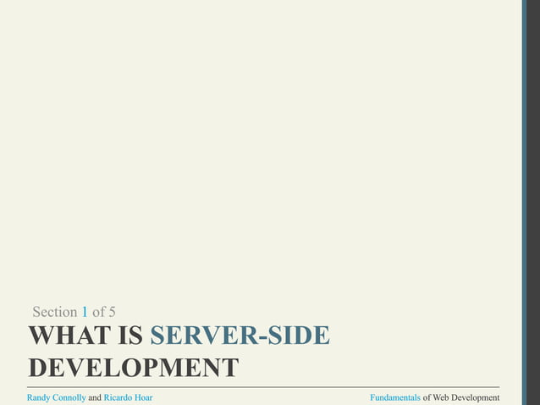

Slide 4
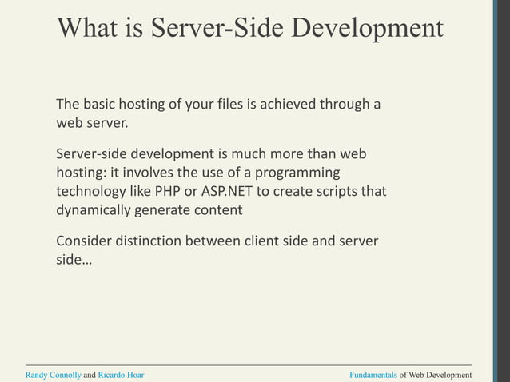

Slide 5
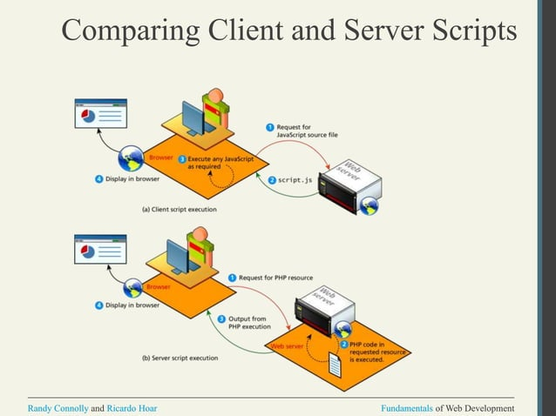

Slide 6
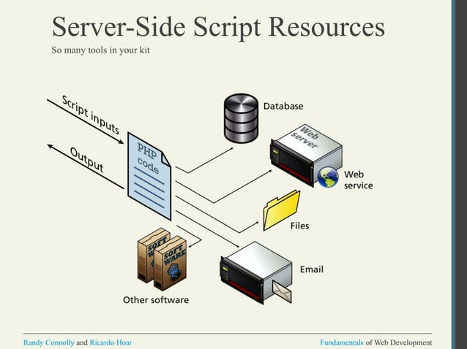

Slide 7
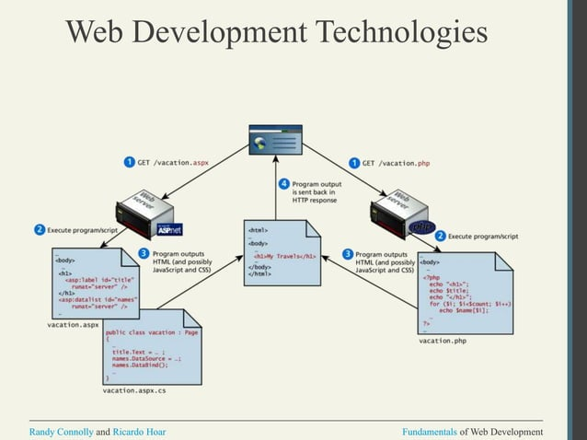

Slide 8
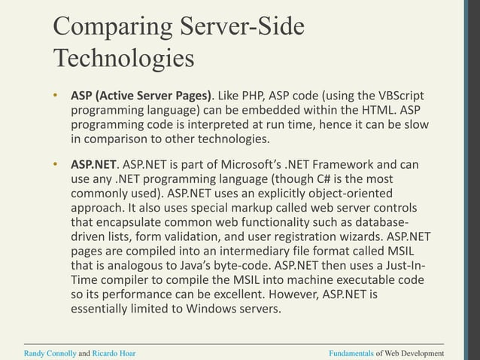

Slide 9
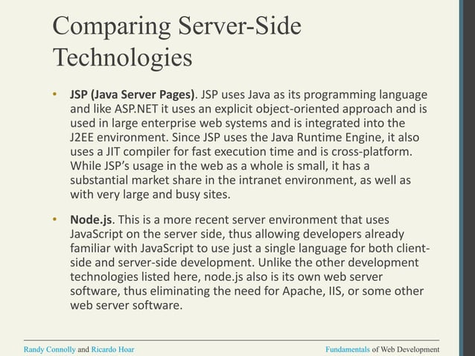

Slide 10
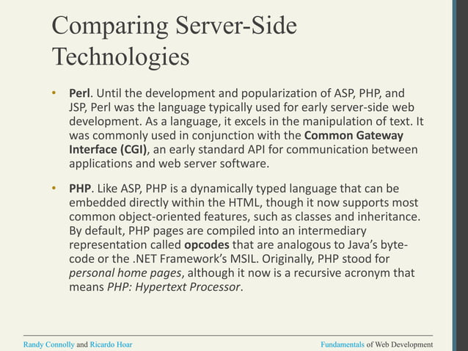

Slide 11
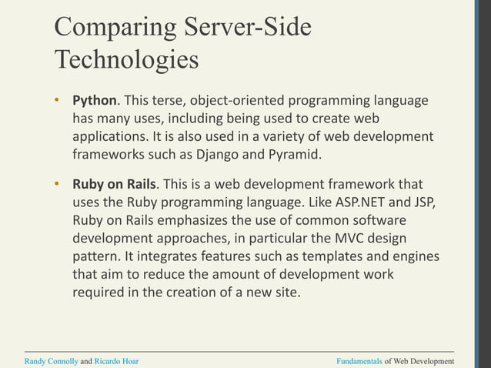

Slide 12
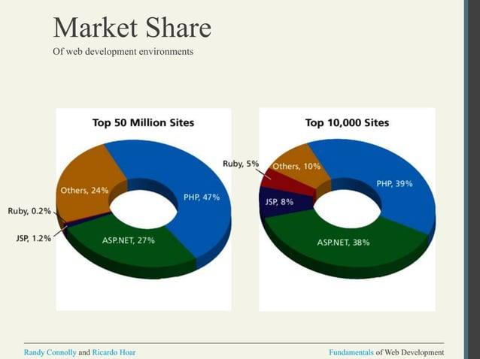

Slide 13
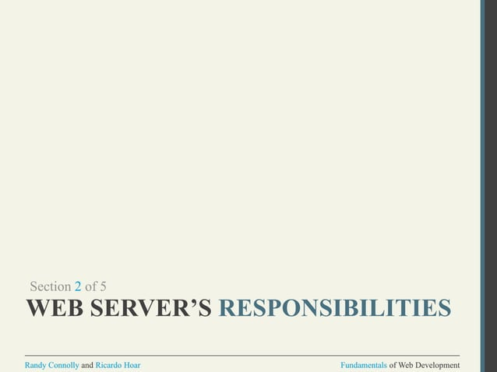

Slide 14
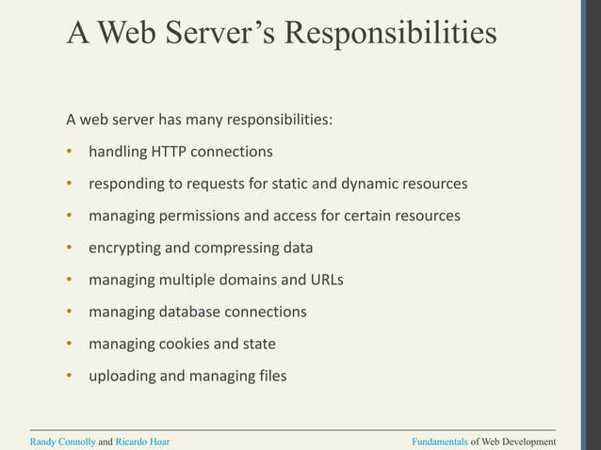

Slide 15
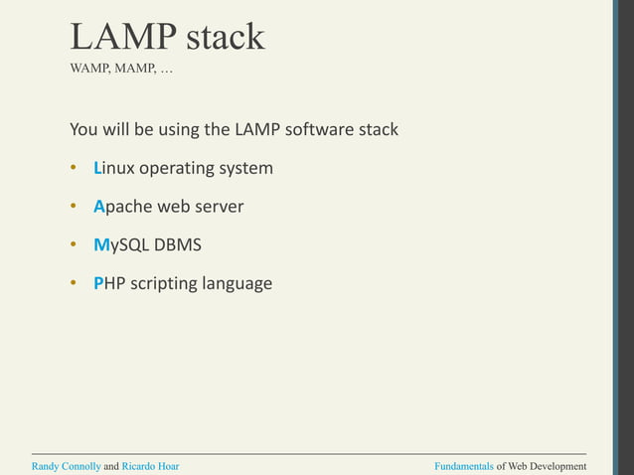

Slide 16
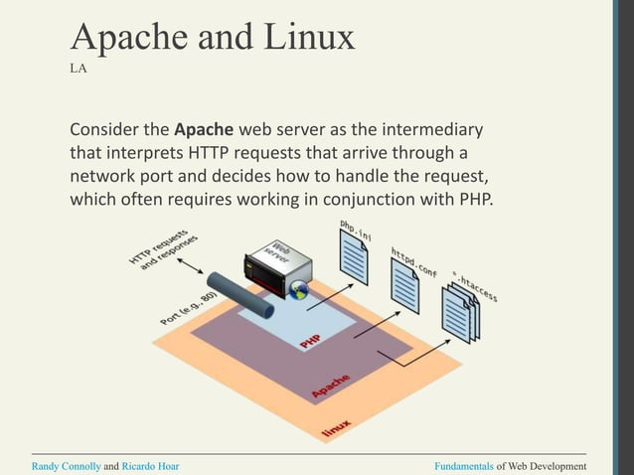

Slide 17
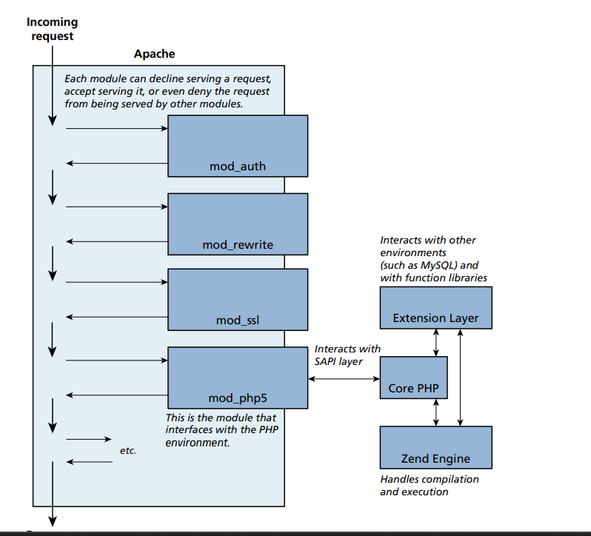
when a request comes into Apache, each module is given an opportunity to handle some aspect of the request. Some modules handle authorization, others handle URL rewriting, while others handle specific extensions.

Slide 18
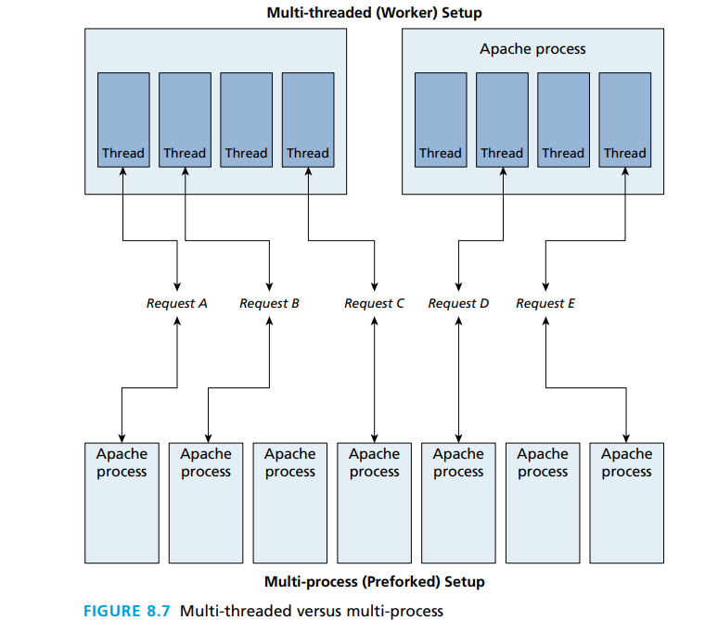
Apache runs in two possible modes: multi-process (also called preforked) or multi-threaded (also called worker)

Slide 19
PHP Internals
PHP core. The Core module defines the main features of the PHP environment, including essential functions for variable handling, arrays, strings, classes, math, and other core features.
Extension layer. This module defines functions for interacting with services outside of PHP. This includes libraries for MySQL (and other databases), FTP, SOAP web services, and XML processing, among others.
Zend Engine. This module handles the reading in of a requested PHP file, compiling it, and executing it. Figure 8.8 illustrates (somewhat imaginatively) how the Zend Engine operates behind the scenes when a PHP page is requested. The Zend Engine is a virtual machine (VM) analogous to the Java Virtual Machine or the Common

Slide 20
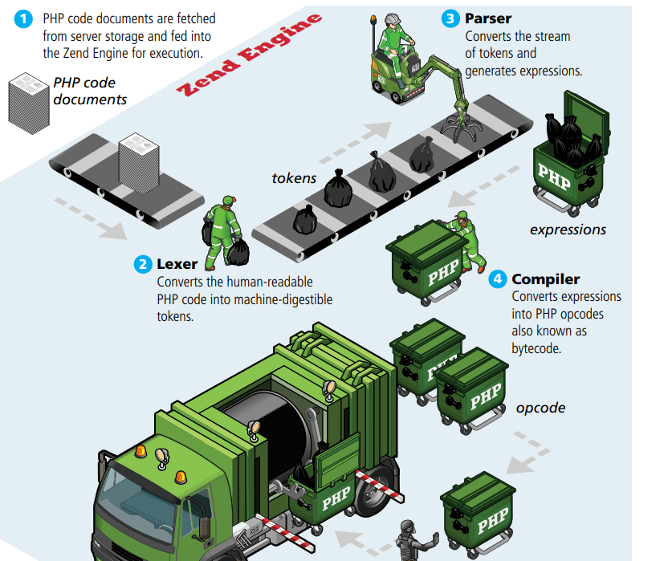
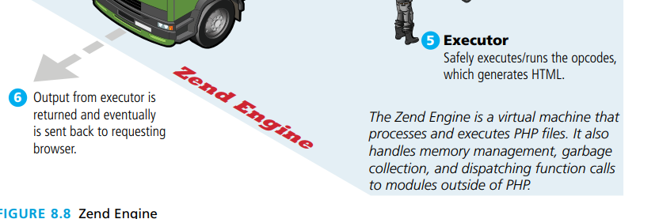

Slide 21
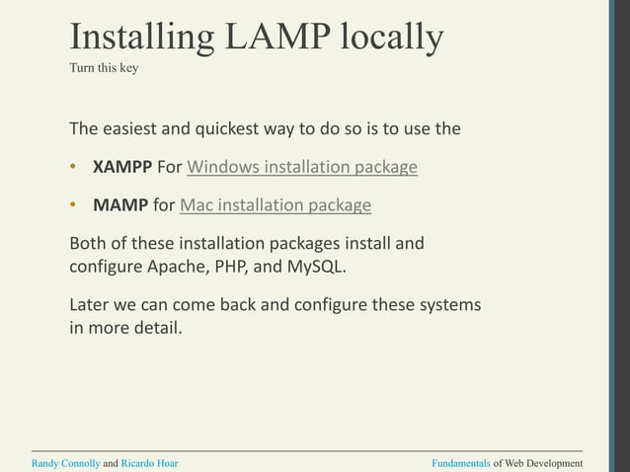

Slide 22
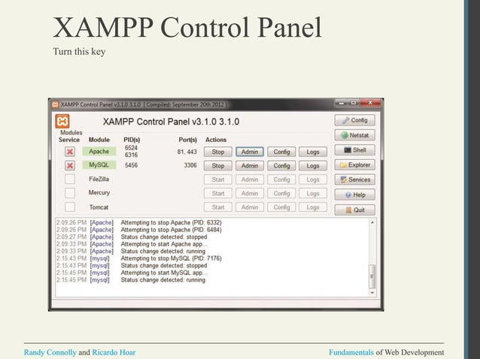

Slide 23
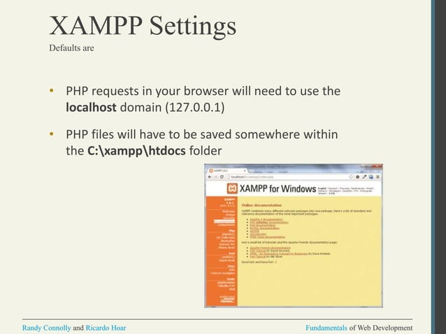

Slide 24


Slide 25
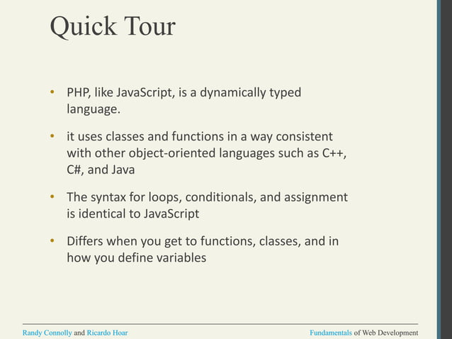

Slide 26
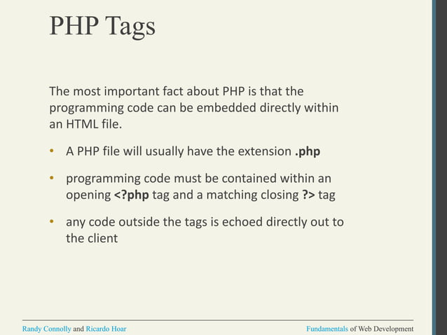

Slide 27
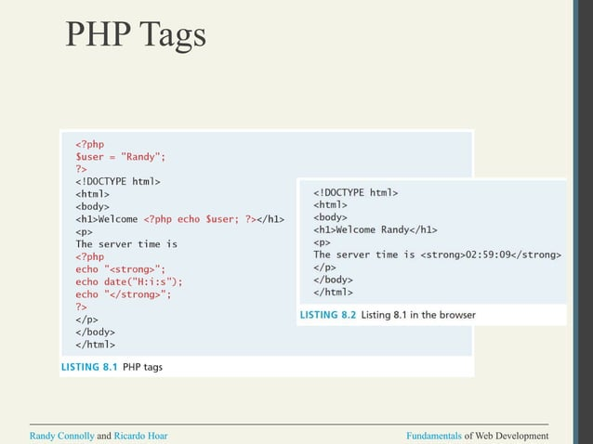

Slide 28
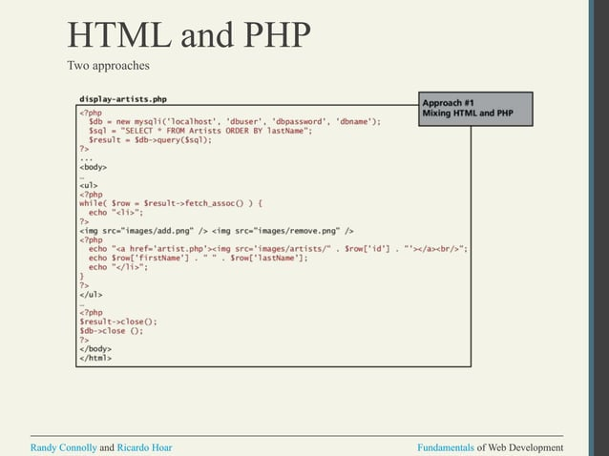

Slide 29
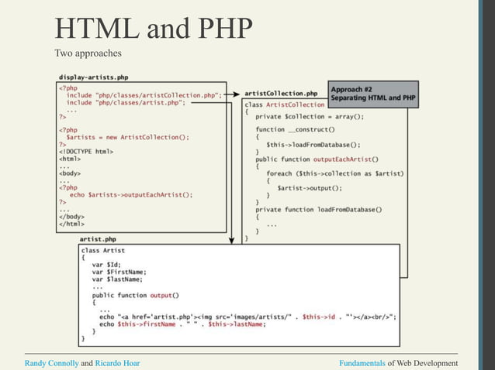

Slide 30
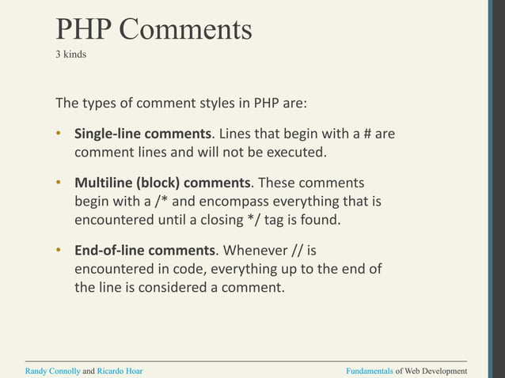

Slide 31
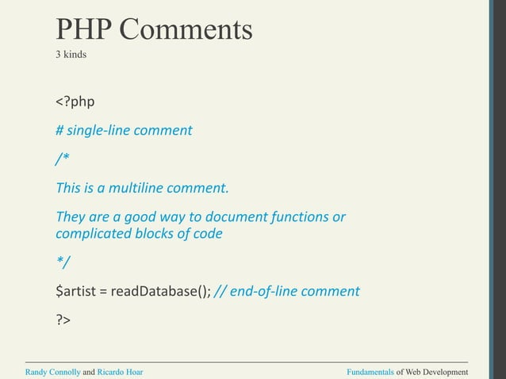

Slide 32
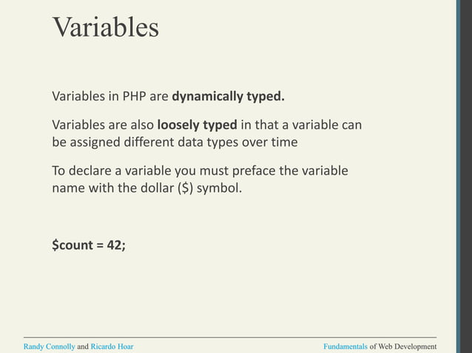

Slide 33
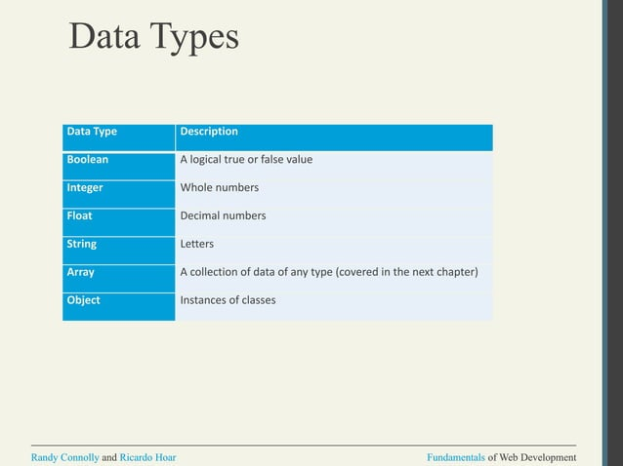

Slide 34
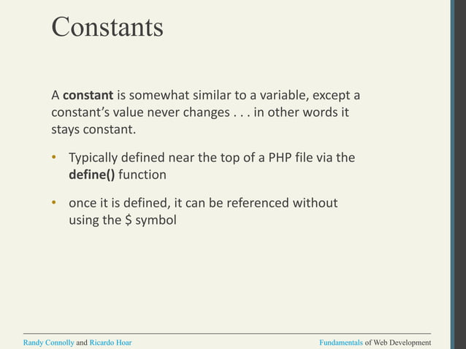

Slide 35
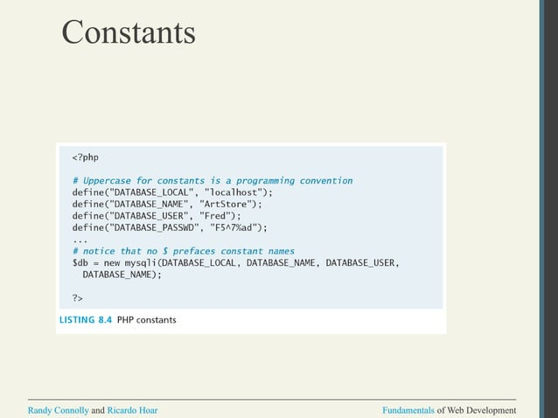

Slide 36
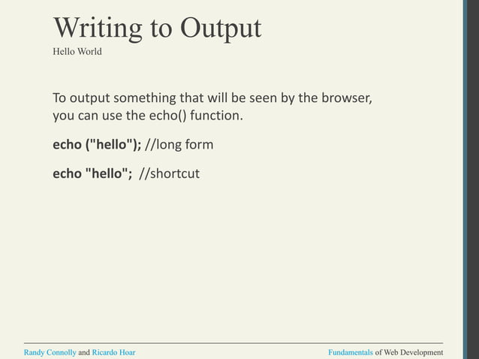

Slide 37
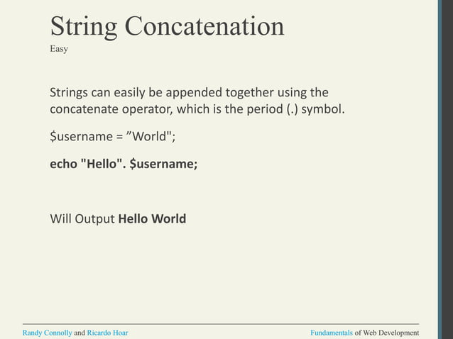

Slide 38
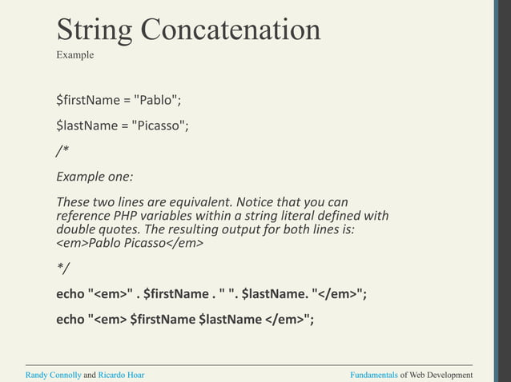

Slide 39
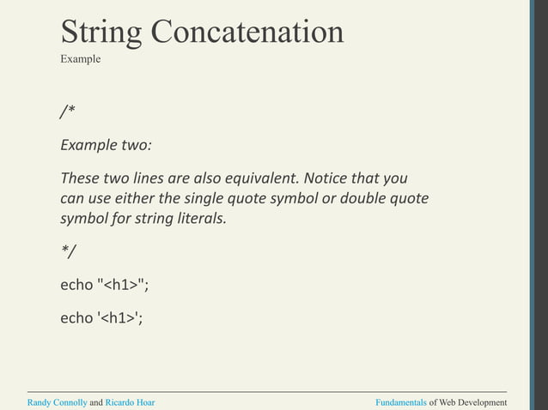

Slide 40
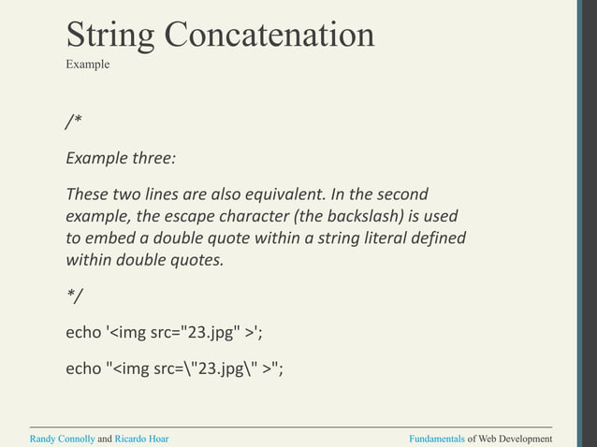

Slide 41
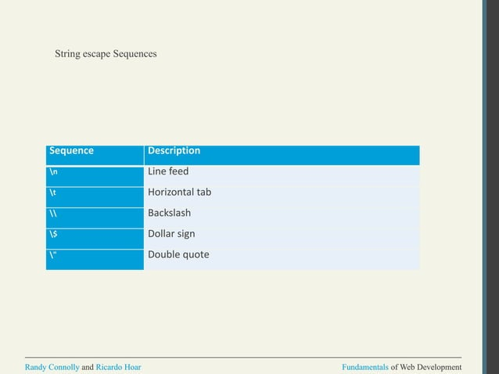

Slide 42
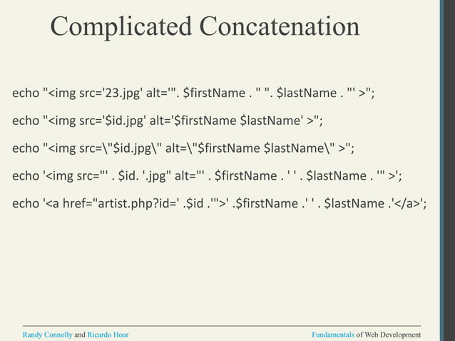

Slide 43
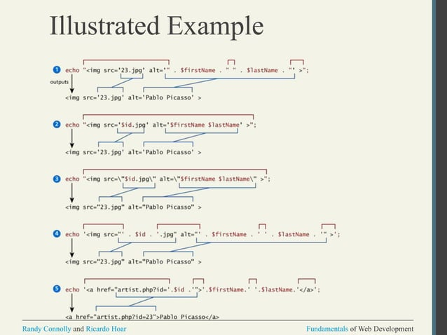

Slide 44
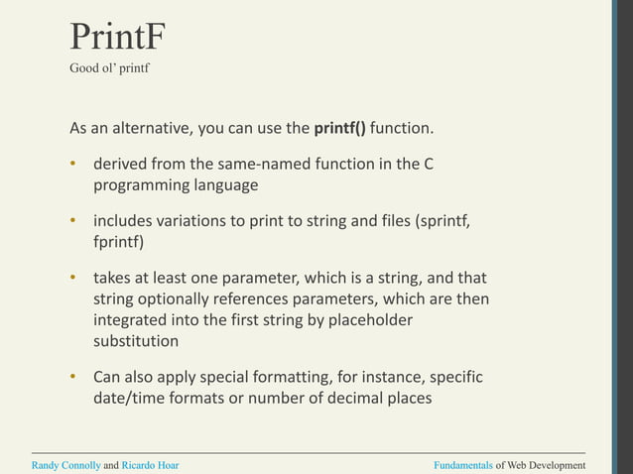

Slide 45
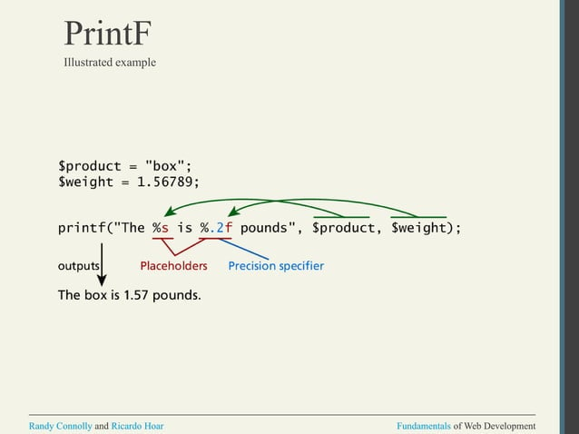

Slide 46
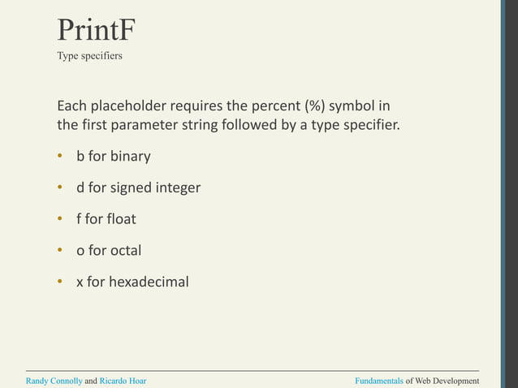

Slide 47
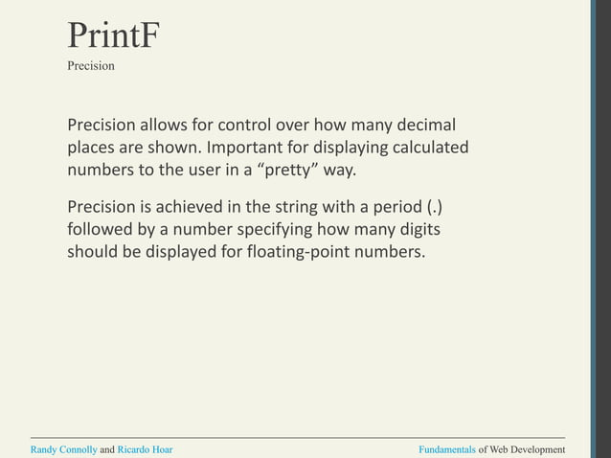

Slide 48
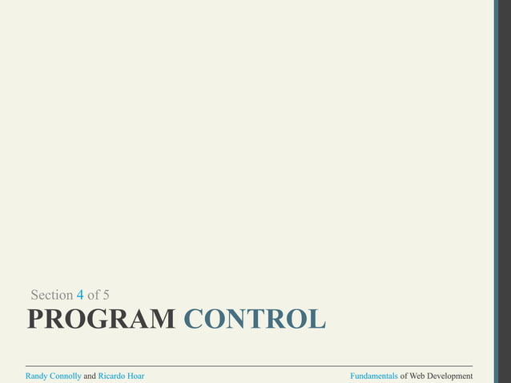

Slide 49
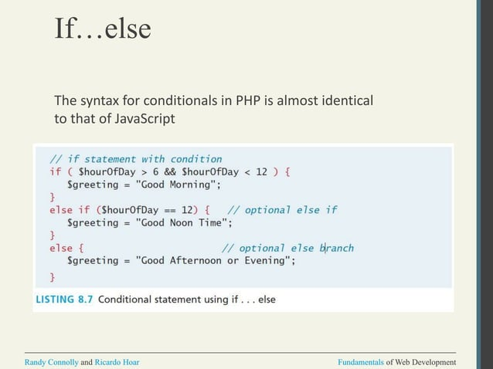

Slide 50
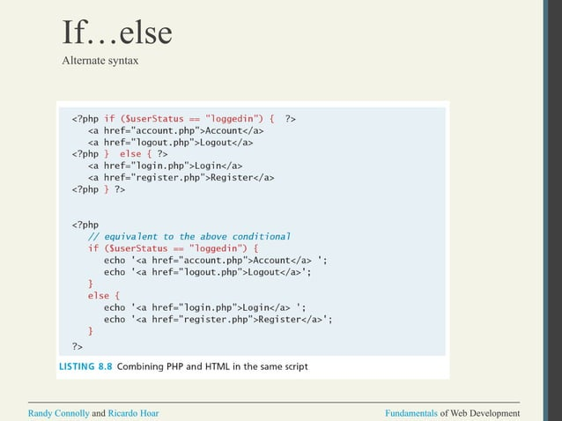

Slide 51
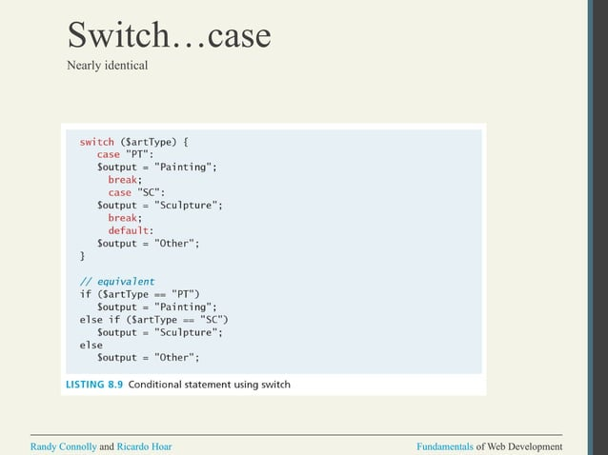

Slide 52


Slide 53


Slide 54


Slide 55


Slide 56


Slide 57


Slide 58


Slide 59


Slide 60


Slide 61


Slide 62


Slide 63


Slide 64


Slide 65


Slide 66


Slide 67


Slide 68


Slide 69


Slide 70


Slide 71


